Slide 1

Oilfield Geochemistry Analysis
Aramco Upstream Solutions Technathon 2019. AI challenge 2
Crystal:
Andrey Erofeev
Evgenii Kanin
Anna Gubanova
Mikhail Doroshenko
where energy comes opportunity
Moscow 2019

Slide 2
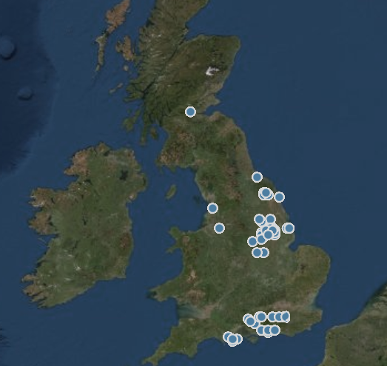
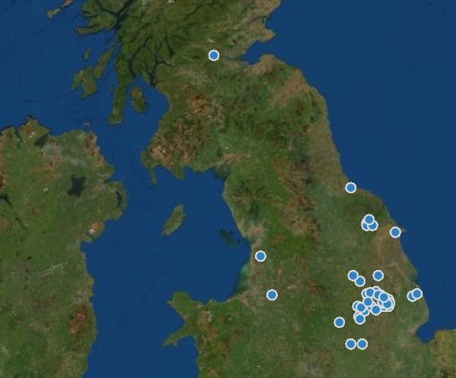

Motivation & Objectives
Predict geochemical properties in the region between wells
Find anomalies in geochemistry-production data
Predict and correlate time-lapse geochemical data variation with production
Create XYZ (longitude, latitude, depth) maps and visualize time-lapse predictions
Data in the interwell space
?

Slide 3


Data preprocessing
CSV files with sample data with laboratory measurements, type of fluid or rocks, coordinates, sampling date
CSV file Production data
Drop useless parameters
Drop parameters with almost empty columns
Clustering wells
Merging tables, matching samples to wells
Filling missing data by nearest neighbors
$$A=\frac{\sum_{i=1}^{N}{\frac{1}{d_{i}}A_{i}}}{\sum_{i=1}^{N}{\frac{1}{d_{i}}}}$$
Features | WH_LAT | WH_LONG | WH_TD_M | SH_DEPTH_TOP_FT | SH_DEPTH_BOT_FT | CSIA_CONC_C1 | CSIA_NC1-NC5 | CSIA_IC4-IC5
Target parameters | GAS_C1 | GAS_C2 | GAS_C3 | GAS_IC4 | GAS_NC4 | GAS_IC5 | GAS_NC5

Slide 4
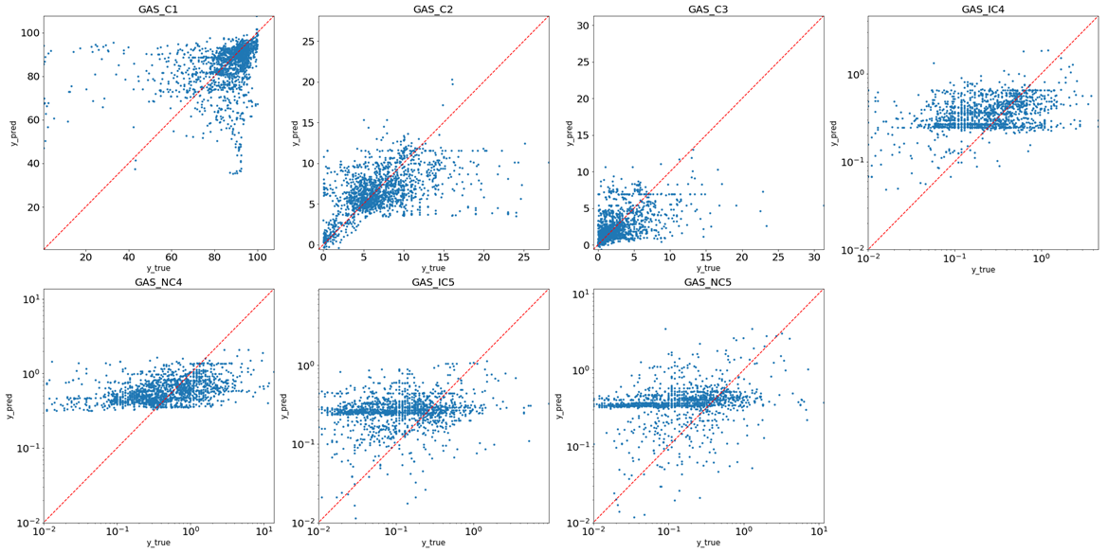








Prediction of gas components. Cross-plots.
$$R^{2}=0.2$$
$$R^{2}=0.22$$
$$R^{2}=−0.1$$
$$R^{2}=0.09$$
$$R^{2}=−0.02$$
GBM (XGBoost ver.) was applied
C2 and C3 components have the best $R^{2}−$score
$$R^{2}=0.09$$
$$R^{2}=−0.05$$

Slide 5
Prediction of gas components. Feature importance.
Gas C1
Target depth
Top depth
Bottom depth
Gas IC4
Latitude
Longitude
Top depth
Gas NC5
CSIA-NC5
Target depth
Latitude
Gas C2
Latitude
Top depth
CSIA-NC1
Gas NC4
Latitude
Longitude
Top depth
The most important features:
Latitude
Top depth
Gas C3
CSIA-NC2
Latitude
Top depth
Gas IC5
CSIA-NC5
Latitude
CSIA-IC5

Slide 6
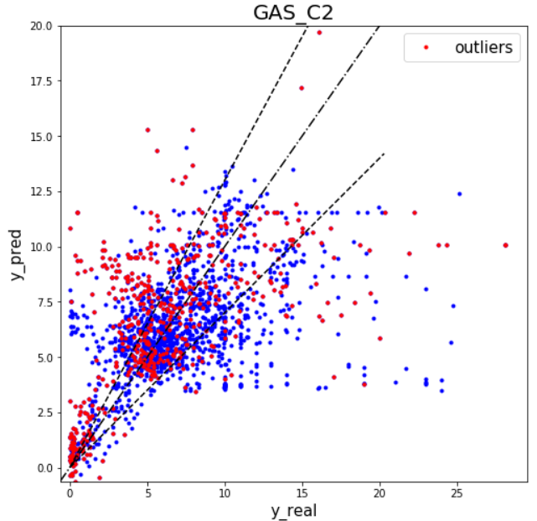
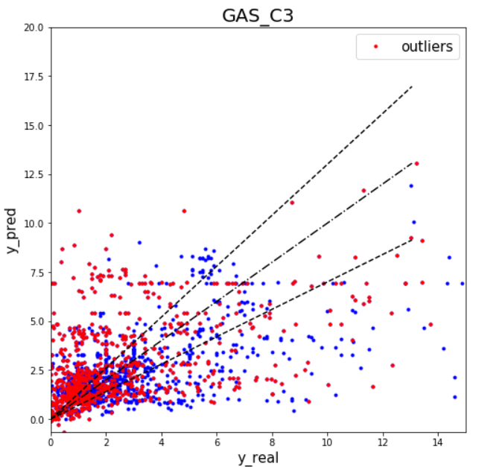

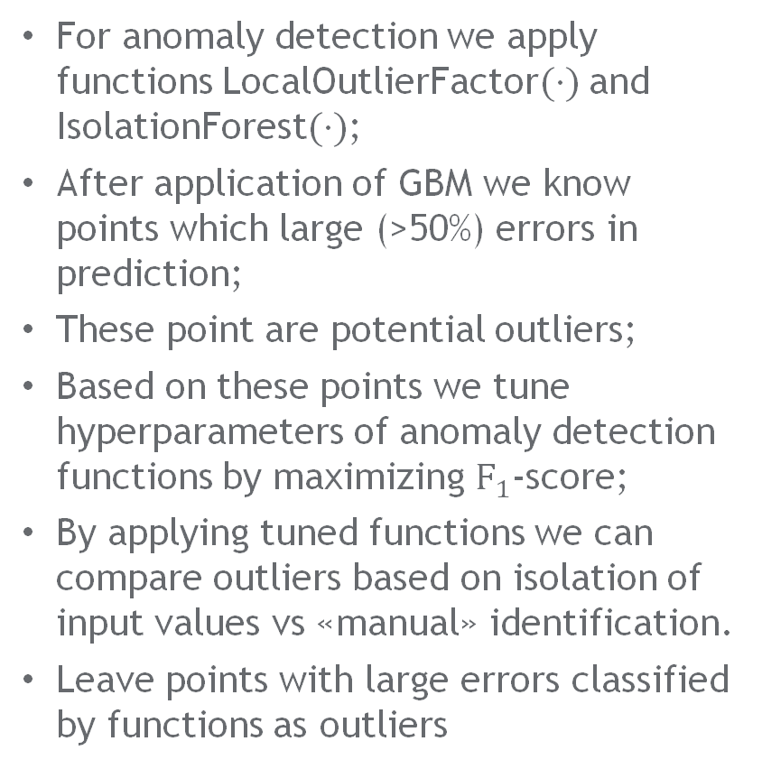
Prediction of gas components. Anomalies detection.
For anomaly detection we apply functions LocalOutlierFactor$(⋅)$ and IsolationForest$(⋅)$;
After application of GBM we know points which large (>50%) errors in prediction;
These point are potential outliers;
Based on these points we tune hyperparameters of anomaly detection functions by maximizing $F_{1}$-score;
By applying tuned functions we can compare outliers based on isolation of input values vs «manual» identification.
Leave points with large errors classified by functions as outliers
v

Slide 7
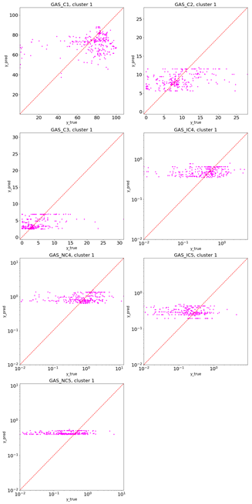
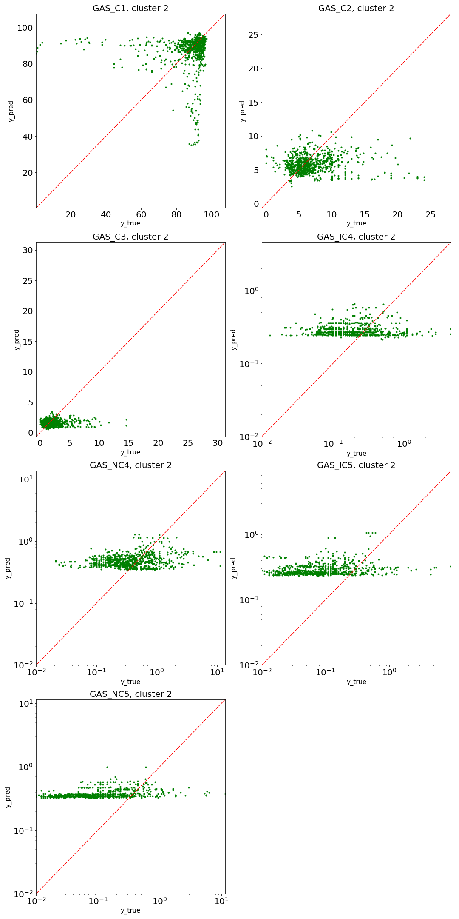
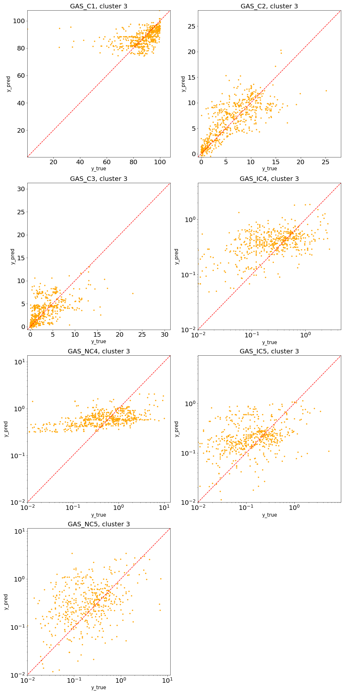
Cluster I
Cluster II
Cluster III

Slide 8
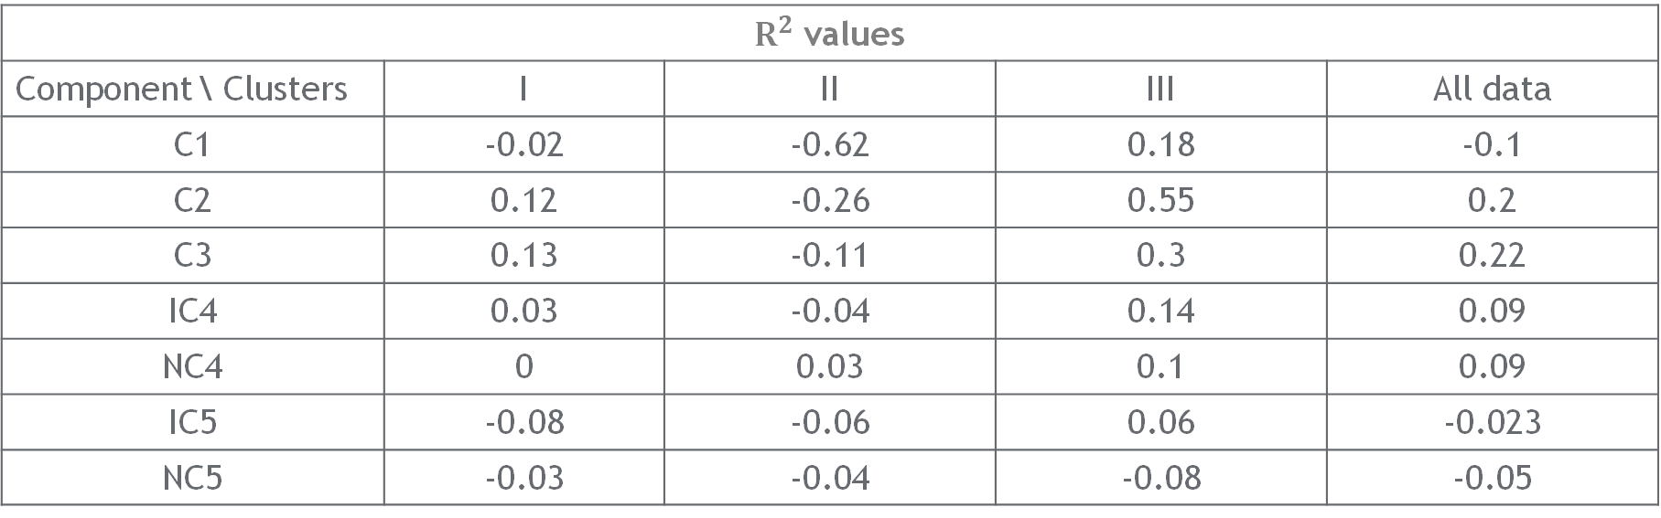
Obtained metrics
$R^{2}$ values
Component \ Clusters | I | II | III | All data
С1 | -0.02 | -0.62 | 0.18 | -0.1
С2 | 0.12 | -0.26 | 0.55 | 0.2
С3 | 0.13 | -0.11 | 0.3 | 0.22
IC4 | 0.03 | -0.04 | 0.14 | 0.09
NC4 | 0 | 0.03 | 0.1 | 0.09
IC5 | -0.08 | -0.06 | 0.06 | -0.023
NC5 | -0.03 | -0.04 | -0.08 | -0.05

Slide 9
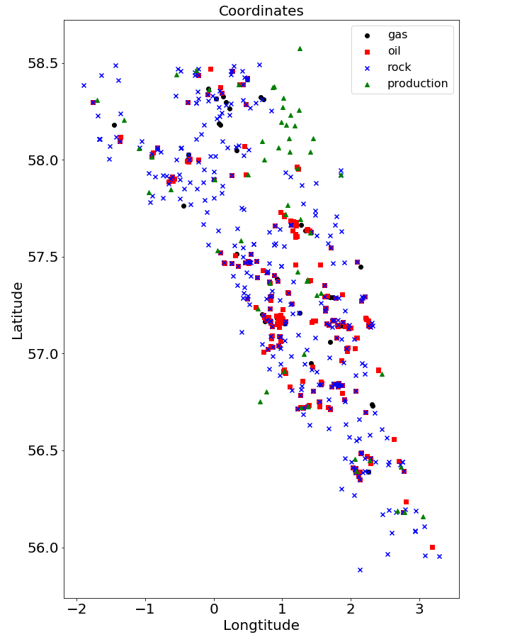
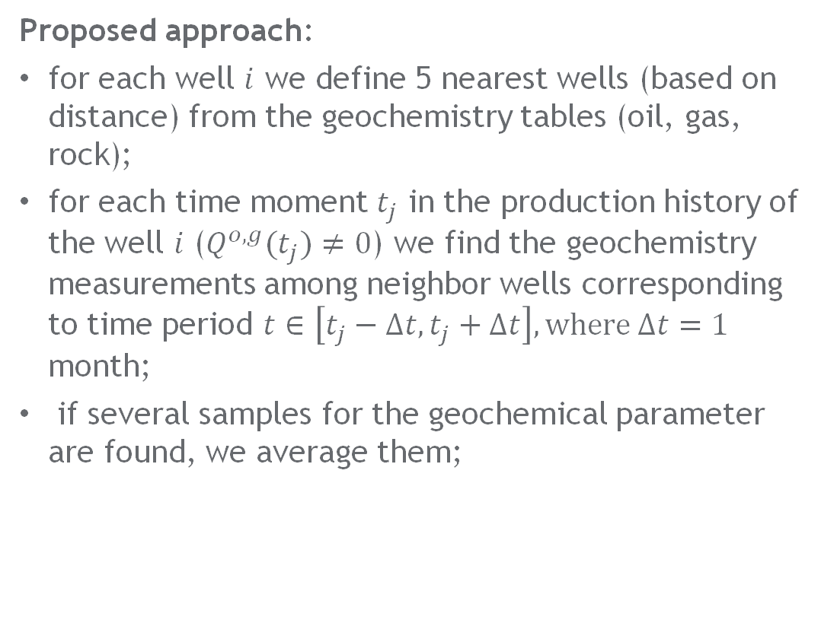
Correlation with production
Proposed approach:
for each well $i$ we define 5 nearest wells (based on distance) from the geochemistry tables (oil, gas, rock);
for each time moment $t_{j}$ in the production history of the well $i$ ($Q^{o,g}(t_{j})≠0$) we find the geochemistry measurements among neighbor wells corresponding to time period $t∈\left[t_{j}−Δt, t_{j}+Δt\right], where Δt=1$ month;
if several samples for the geochemical parameter are found, we average them;
Notes:
Divide coordinate data from different files into well segments
Concatenate and average geochemical properties and production data for every segment versus time
Perform feature engineering and analyze which of geochemistry properties significantly impacts the production
Find correlations between every geochemical parameter and oil production rate
Plot interpolated surface for predicted values
Choose the most appropriate places to drill new wells

Slide 10
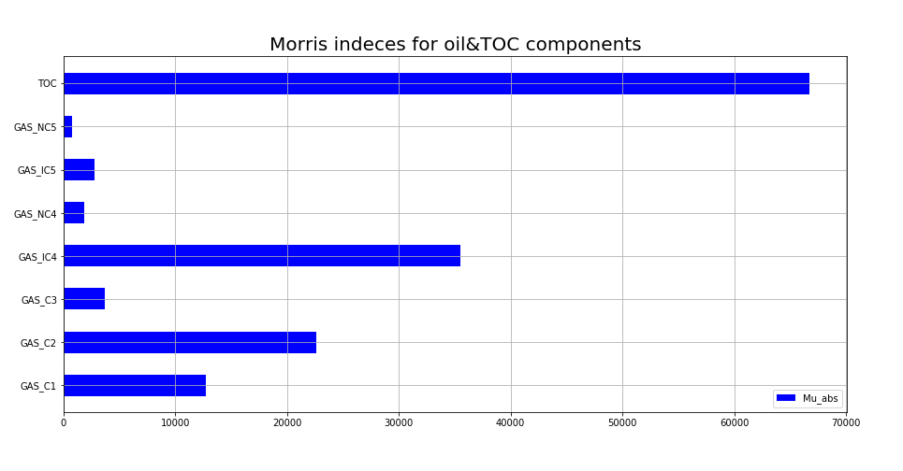
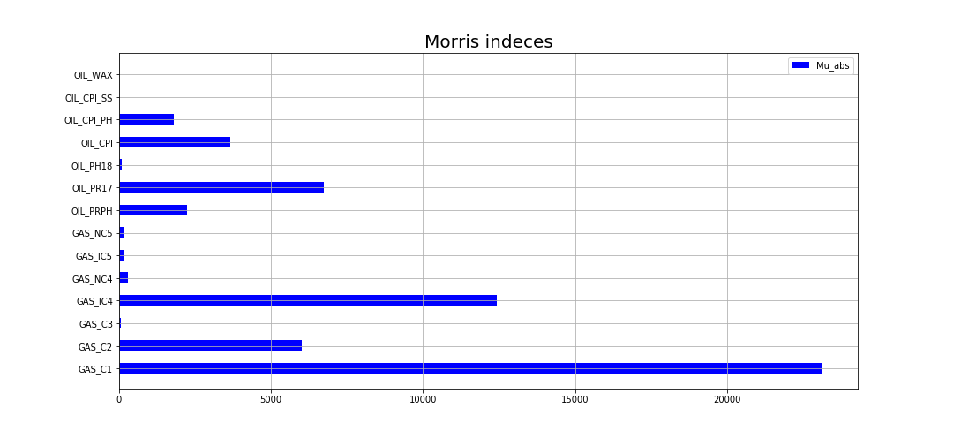
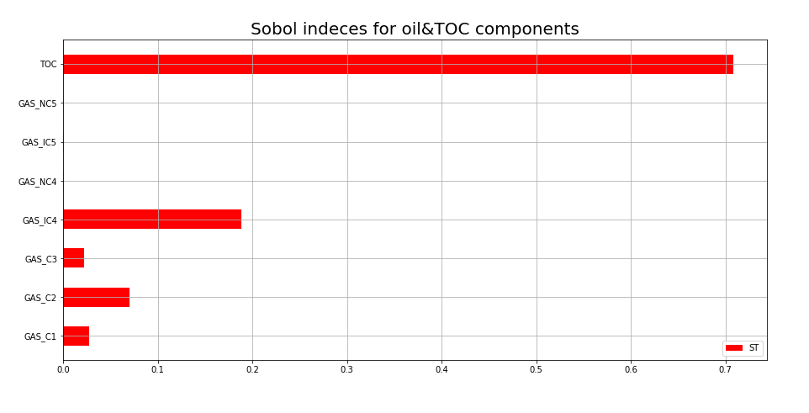
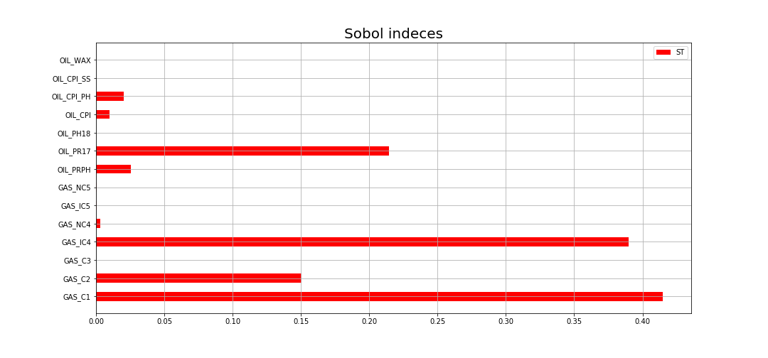
Sensitivity analysis

Slide 11
Time-lapse dependency of geochemical parameters

Slide 12


Conclusions
Model for gas content prediction was constructed;
The most influential features on gas content were identified;
Anomaly detection utilizing ML tools was performed;
Production data with geochemical properties were combined;
The most important geochemical parameters for production rate by Sobol and Morris indices were defined;

Slide 13
Further research
Explore more data
Find depth-dependency of geochemical parameters

Slide 14
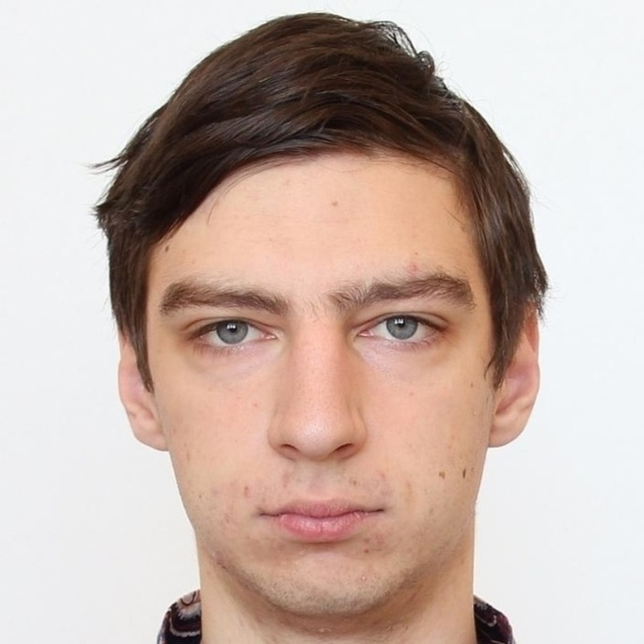
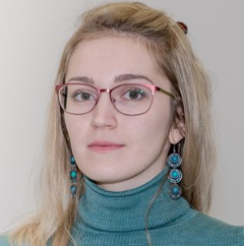
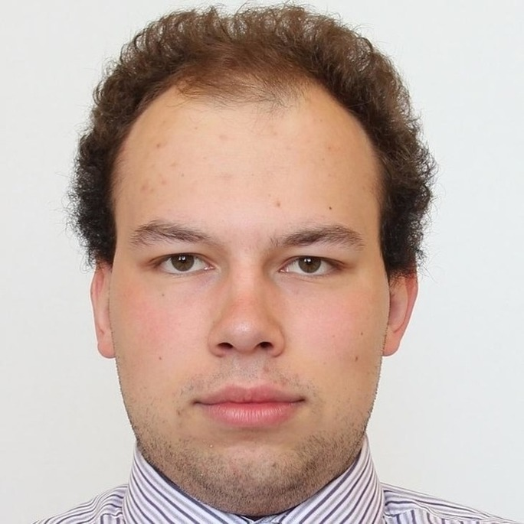
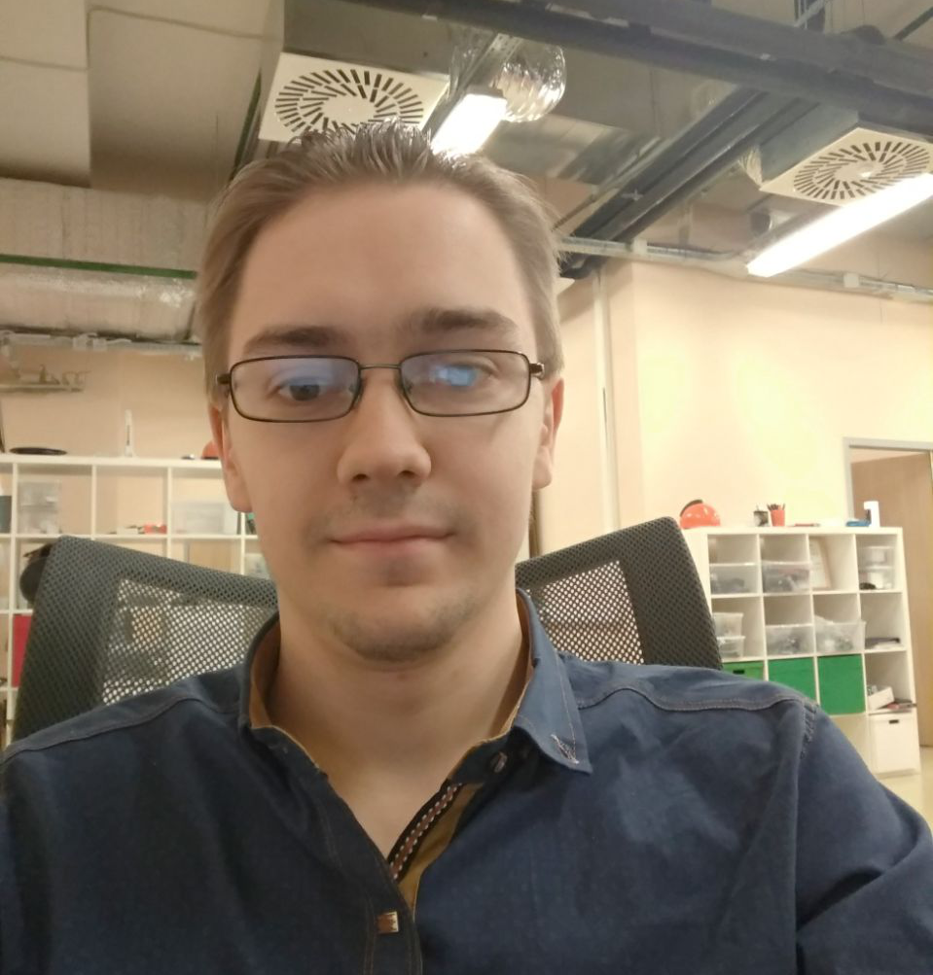
Team members
Andrey Erofeev
1st year PhD, Skoltech
Digital Petroleum
Andrei.Erofeev@skoltech.ru
Anna Gubanova​
2nd year PhD, Skoltech
Digital Petroleum
Anna.Gubanova@skoltech.ru
Evgeny Kanin
1st year PhD, Skoltech
Multiphase Systems Lab
Evgenii.Kanin@skoltech.ru
Mikhail Doroshenko
2nd year master, MIPT
Navigine
m.doroshenko@navigine.com
https://github.com/GAnna22/Crystal_challenge2

